Slide 1

"Optimizing Sales for Dar_Al Amoudi Store Using A/B Test
Dar Al -Amoudi Store is an electronic store for the sale of natural Yemeni honey through the Facebook page and Instagram account,
The store meets honey requests inside and outside Yemen.
In conjunction with the updates of the Yemeni honey market, in these days we have come to us the “Sumar” honey season, which is one of the natural types of Yemeni honey.
We are preparing in the Dar Al -Amoudi store to launch an advertising campaign for a new season of ‘Sumar' honey, and we want to improve the marketing strategy to increase sales by conducting A/B tests.
A
B

Slide 2
A/B Testing Infographics
1- Setting goals and standards.
2- Define the target audience and KPI.
3- Create ads.
4- First A/B test.
A/B testing
5- Second A/B test.
6- Interpret results.
7- Summarize insights.

Slide 3

Setting goals and standards
The goal of our A/B testing project for our store is to determine the most effective marketing strategy for increasing sales of natural honey products during the new ‘Sumar’ season.
The project aims to compare the performance of two different images and two ad texts to determine which combination leads to increased sales.
By conducting this A/B testing project, we can improve its advertising strategy and improve sales for Dar Al-Amoudi Store.

Slide 4
Define the target audience and KPI
We identified the appropriate audience in terms of location, age, sex, interests ... etc.,
to create more relevant and effective ads for our audience.
The metric we will use is CPC (link cost per click) Messaging conversations started

Slide 5
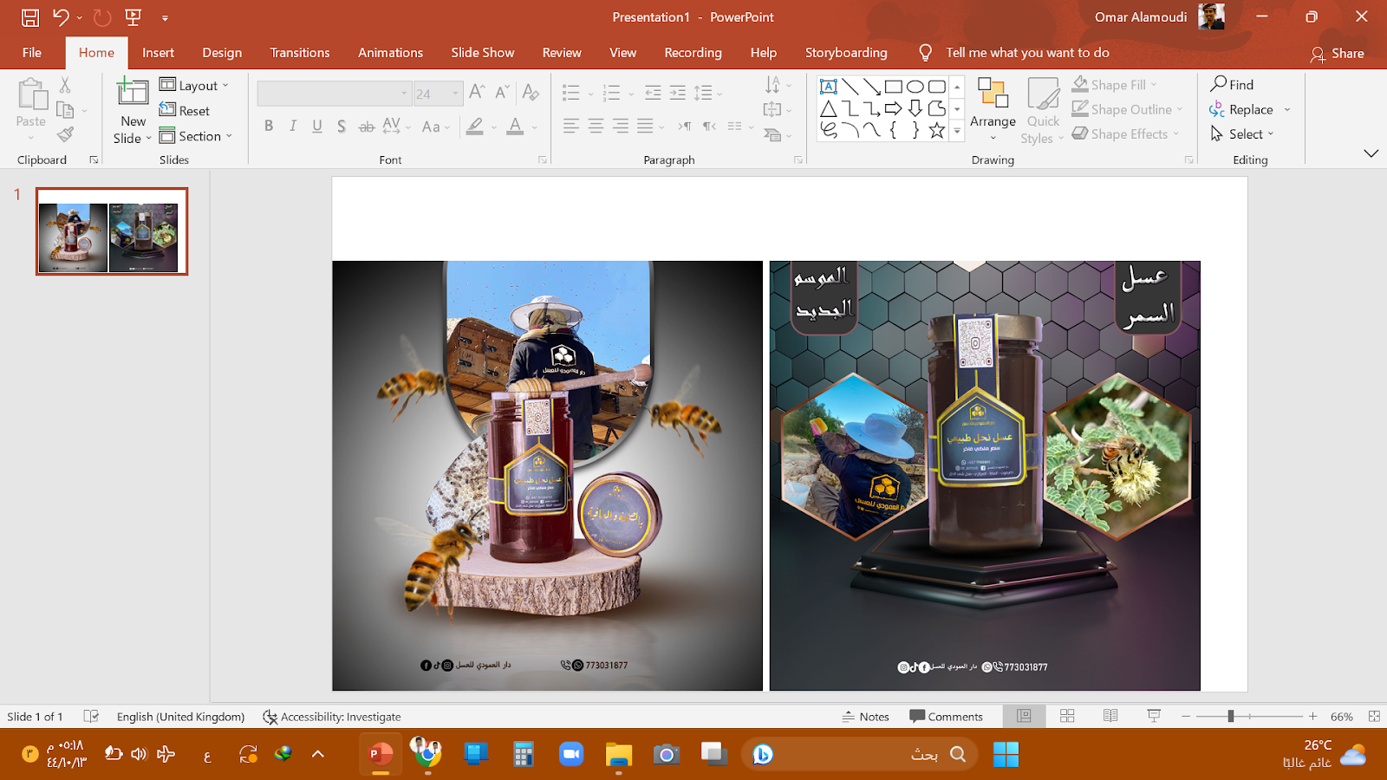
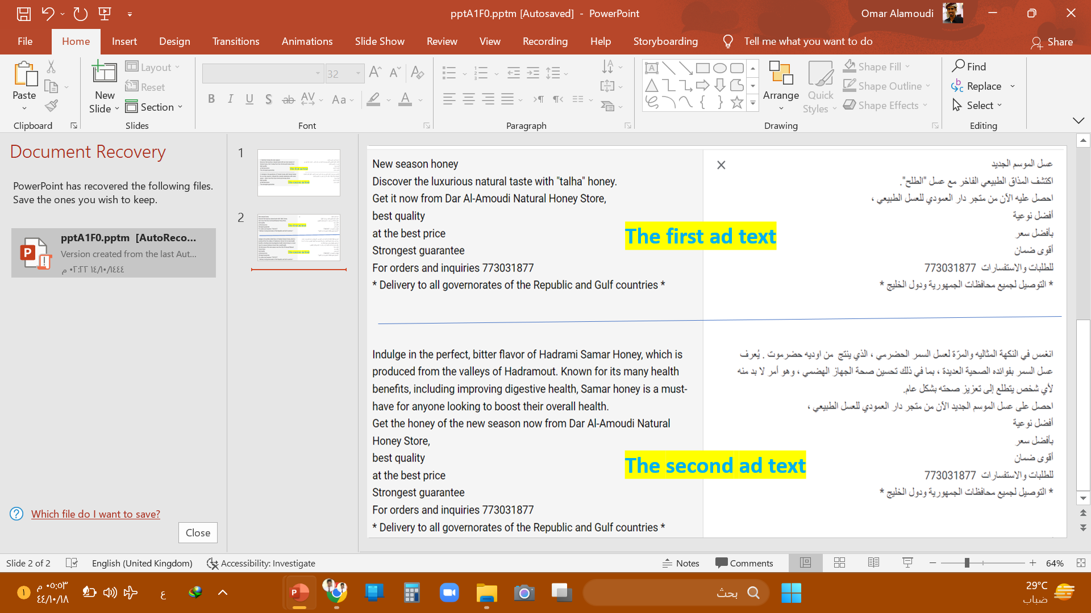
Create ads
To achieve this goal, we chose two images that reflect the honey of the new season. One of the images has explanatory texts within the image, while the other image does not. In addition, the store also set two ad scripts to promote the new season's honey.
To select the most effective ad image and text in increasing sales, we at Dar_Alamoudi store are planning to conduct an A/B testing project on our Facebook business account. By comparing the performance of the two images and ad texts, we will be able to determine the most effective options for increasing sales of natural honey products.

Slide 6
The First A/B Test
We first do a test to determine the most effective image in bringing the most transfers to increase the collective.
We will create a single advertising campaign that contains two Ad Sets that each Ad Set contains an advertisement so that all variables are equal except for the two pictures differ.
A
B

Slide 7
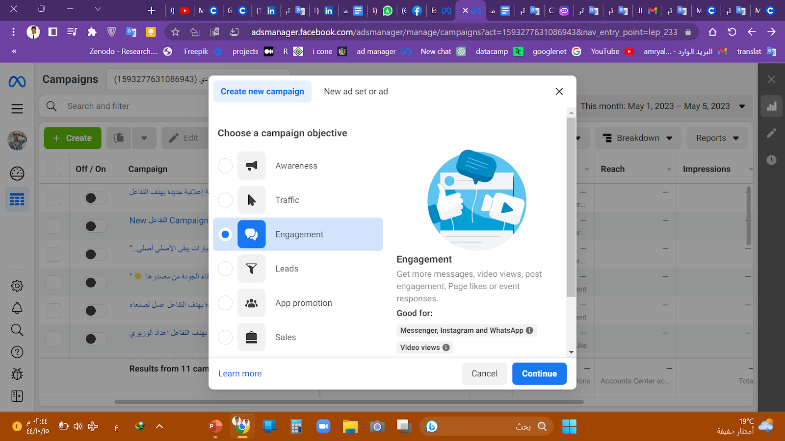
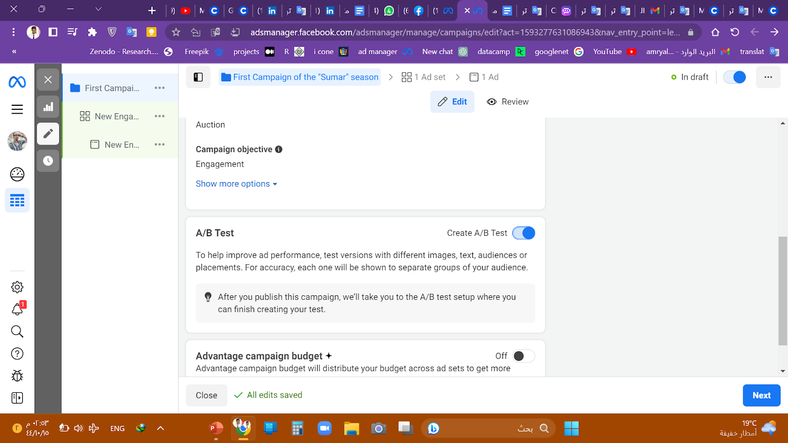
Work in the Facebook ads manager
Create an advertising campaign
We move to the director of Facebook ads and then we chose the goal of the advertising campaign, which is the Engagement.
Then we moved to the campaign preparation page, and we called it the First Campaign For The ‘Sumar’ Season, and we activated the A/B test button.

Slide 8
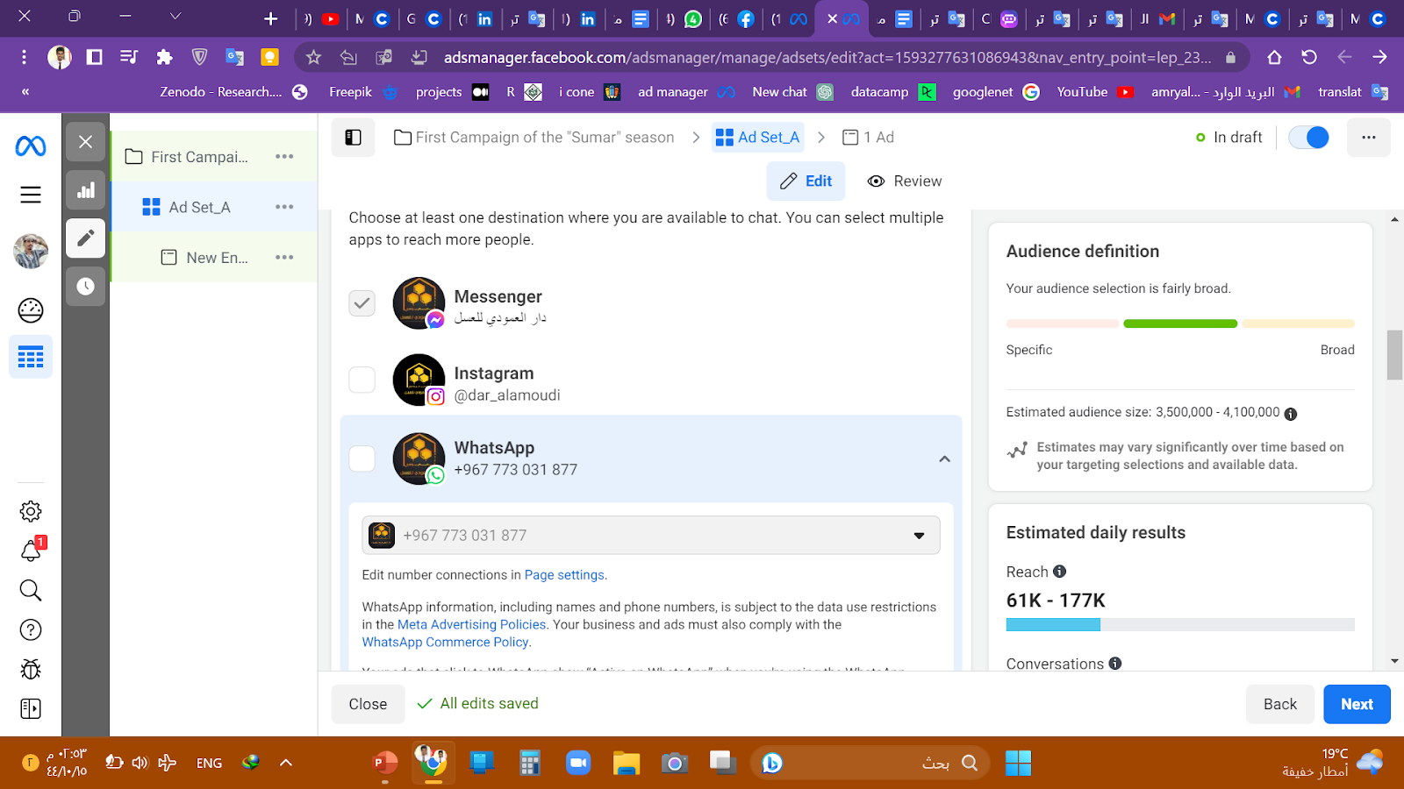
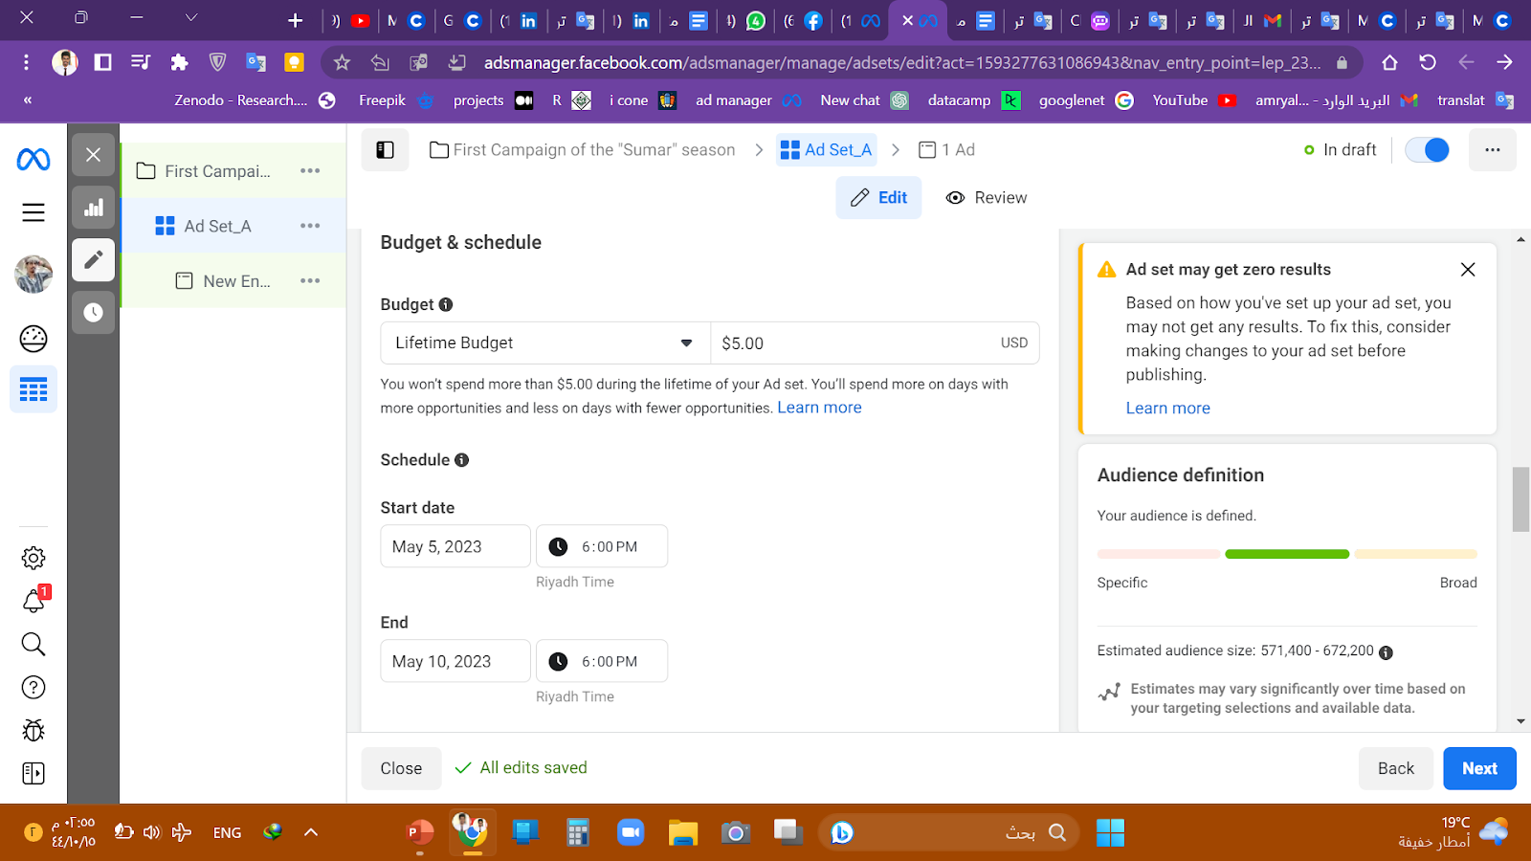
Coordination of the Ad Set
Then we moved to the advertising group page, which we called the Ad Set_A to distinguish between the ads, and we chose the transfer to the Messenger application.
Hence we allocated a total budget of $5 for five days.
Note: “The budget and time we chose are not appropriate, but rather for training”.

Slide 9
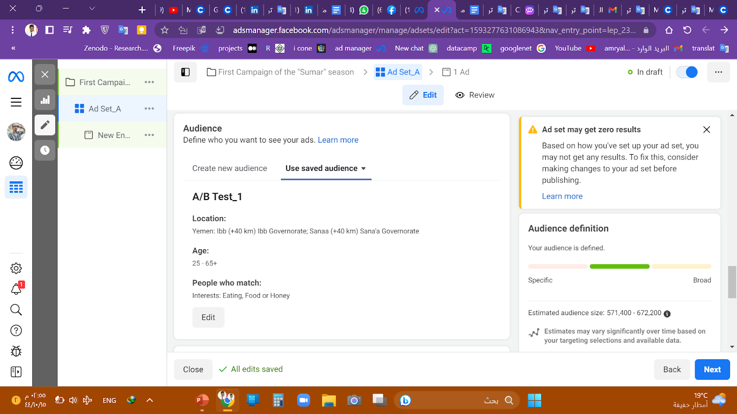
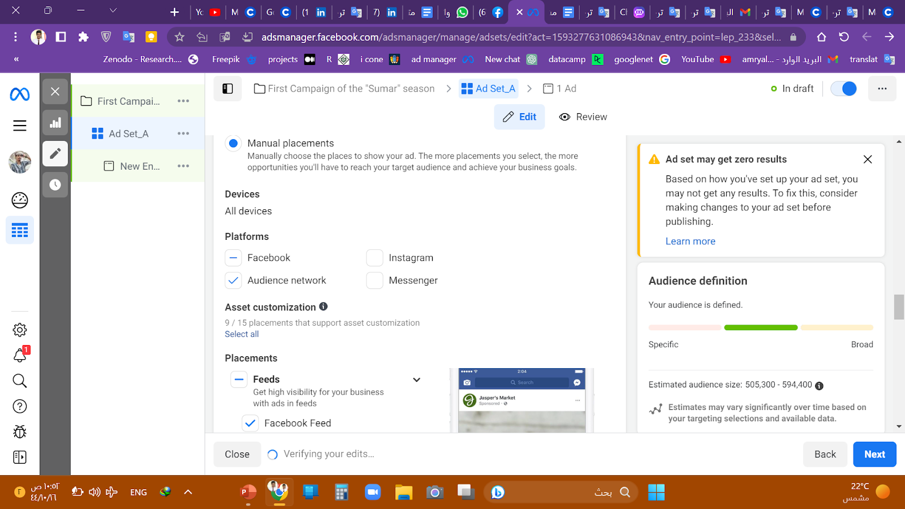
Coordination of the Ad Set
Then we used the audience previously preserved, as we chose the target sites, age groups, sex and interests.
And then we chose the sites manually, where we chose Facebook and the audience network to take into account the budget.

Slide 10
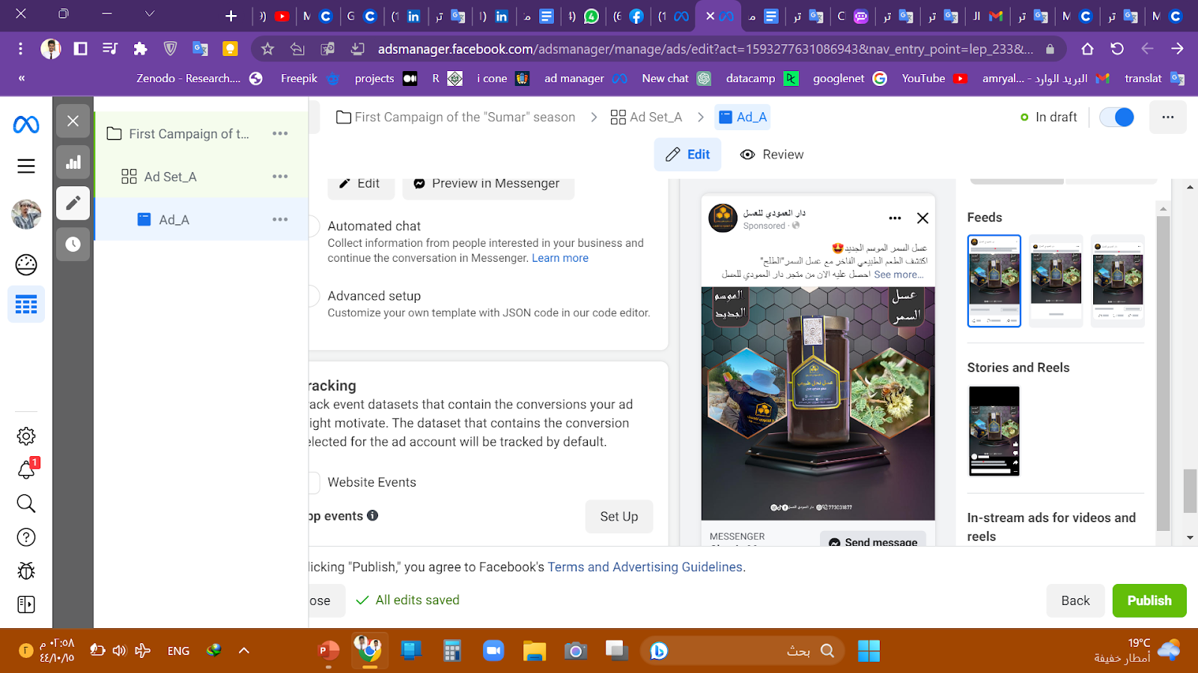
Coordination of the Ad
Then we moved to the advertising page and called it Ad_A for the ease of discrimination and we chose the image that carries explanatory texts.
We wrote the basic text:
")Summer" Honey, the new season 😍
Discover the luxurious natural taste with "Summer" Honey “Talh” Get it now from Dar Al-Amoudi Natural Honey Store,
Best Quality
Best Prices
And Strongest Guarantee
For orders and inquiries 773031877
Delivery to all governorates of the Republic and countries Gulf(
*Note* The text written in the advertisement is in Arabic
Then we click on the publish button

Slide 11
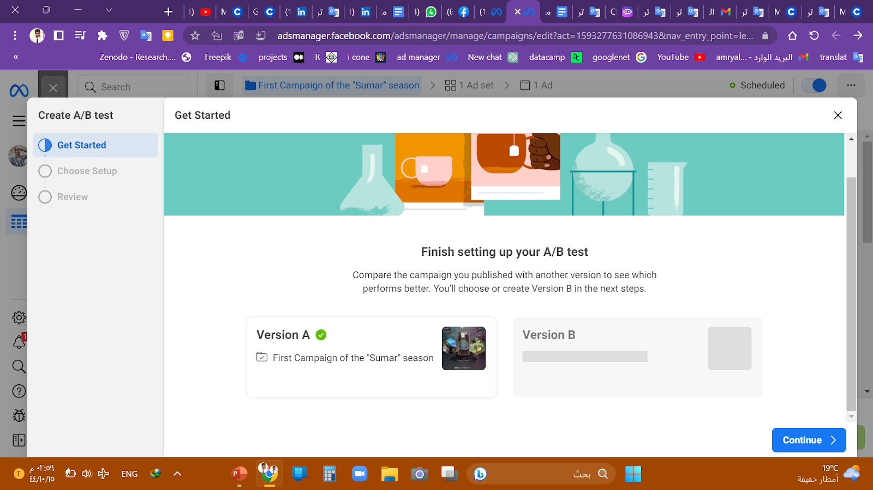
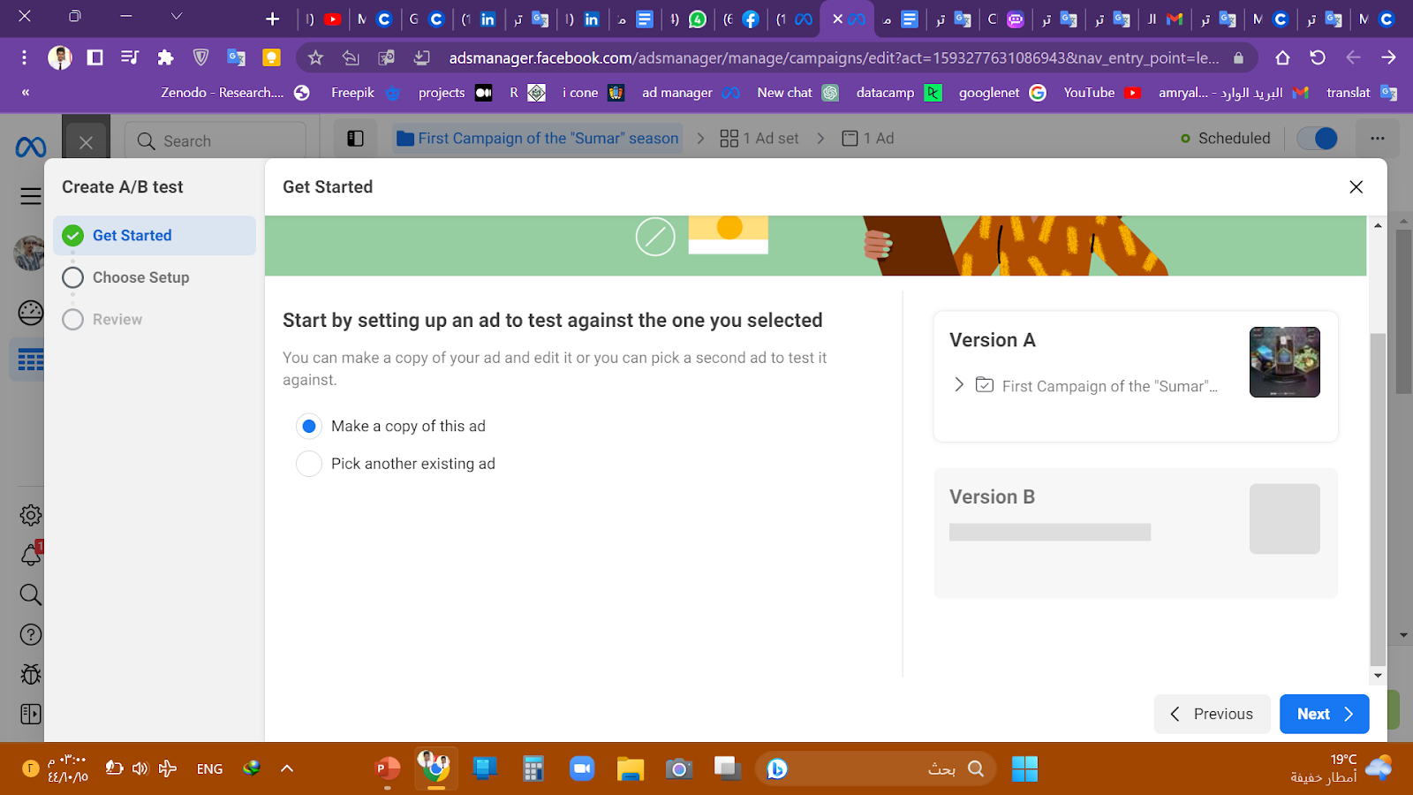
Coordination of the A/B Test
After publishing the ad campaign, a window appears for us to complete the A/B test steps, and we made a copy of the ad we created.

Slide 12
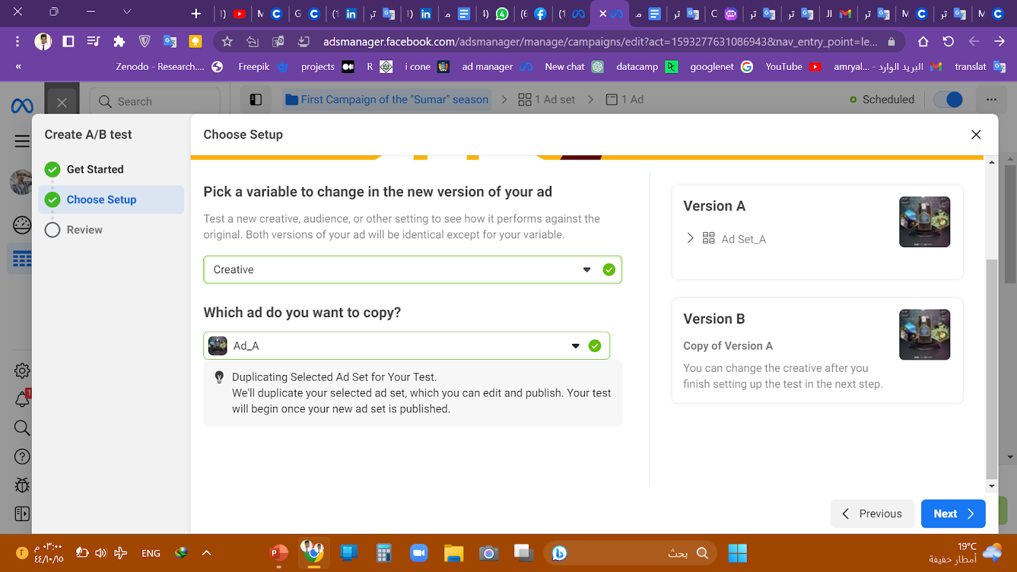
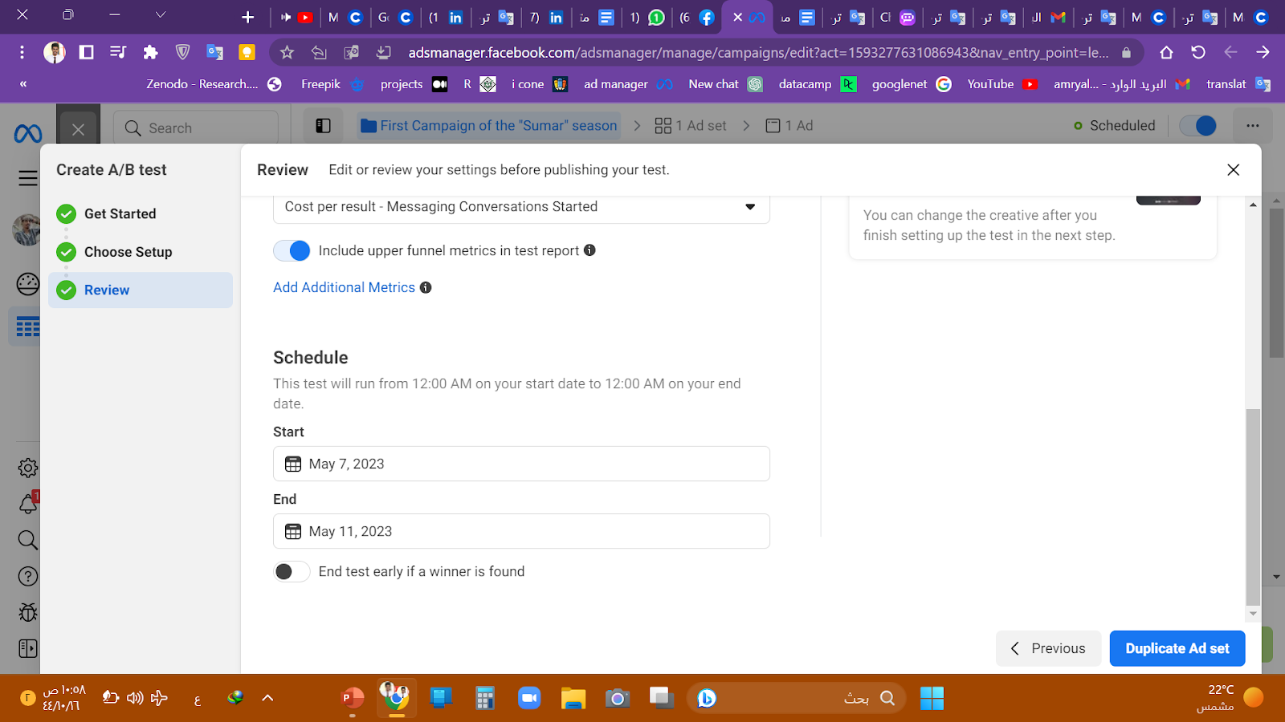
Coordination of the A/B Test
And since we want to change only the image, we choose the variable to test and choose the Creative variable.
Then we put the name of the Photo test and set the main scale to determine the winning version. CPC (link cost per click) Messaging conversations started.
And then by keeping the same time for the previous advertisement,
and we stopped the button, it is the test when creating the winner.

Slide 13
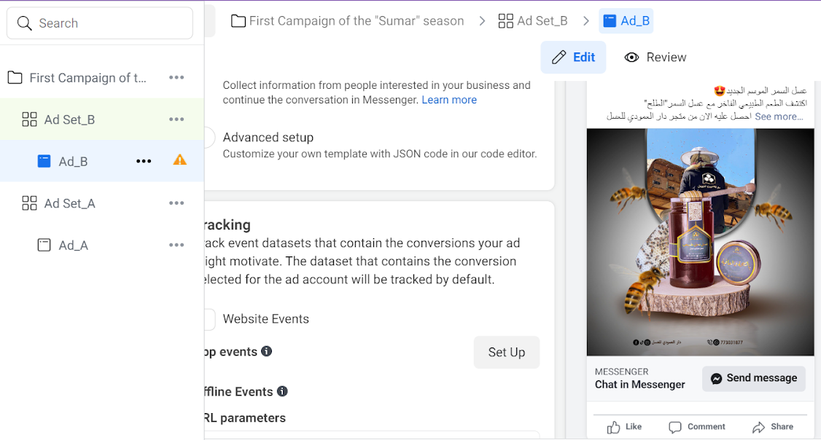
Coordination of the Ad B
And then we clicked on Duplicate the Ad Set and moved to Ad settings B, where we created an ad set within the ad campaign that we created previously and it contains the same previous ad.
We first modify the name of the ad set and the ad to Ad_set_B & Ad_B for clarification.
and we will change only one variable, which is the image that does not contain explanatory texts.
We left all the variables on what appears to be and others only, and we clicked on publishing.

Slide 14
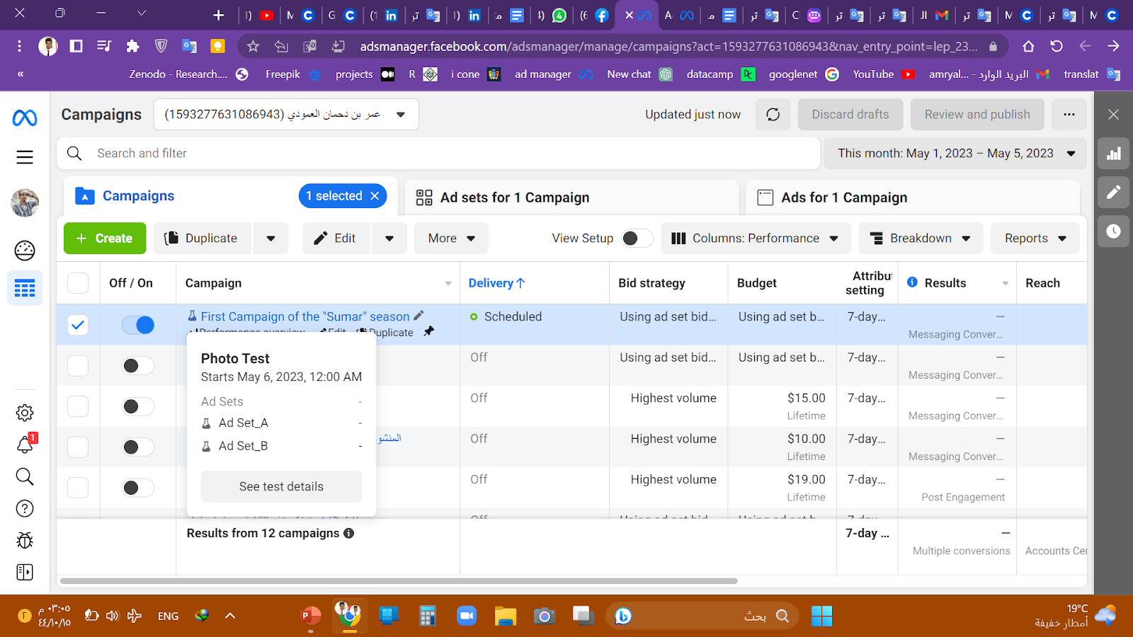
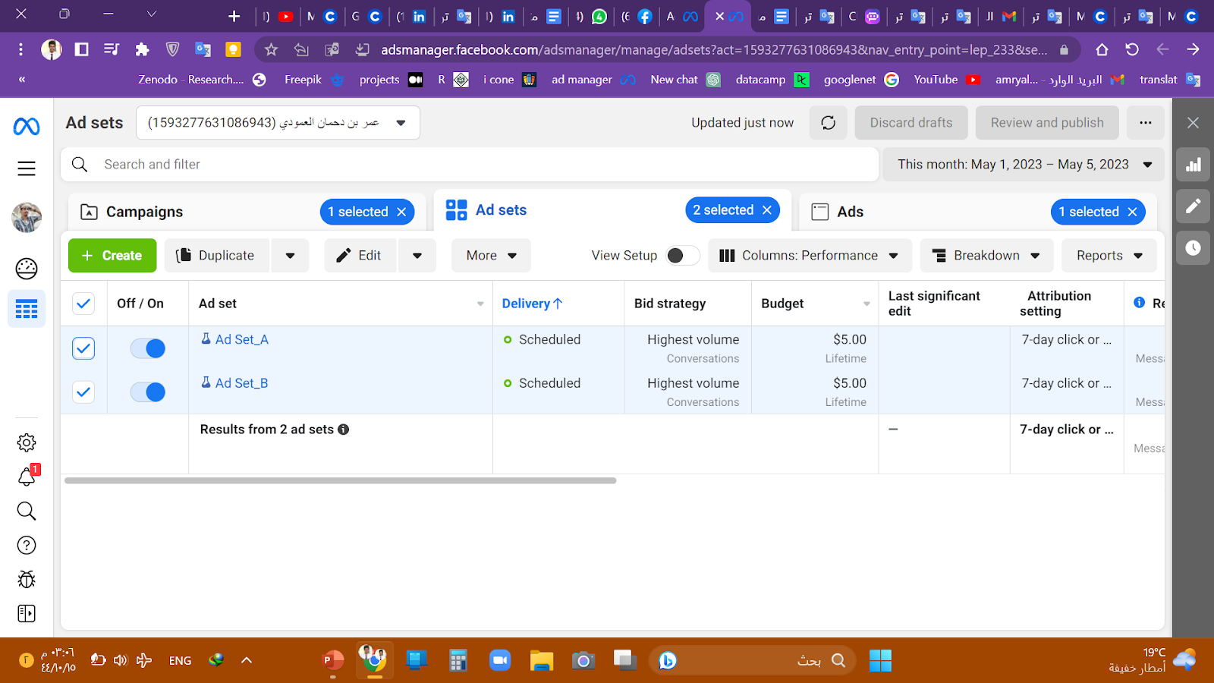
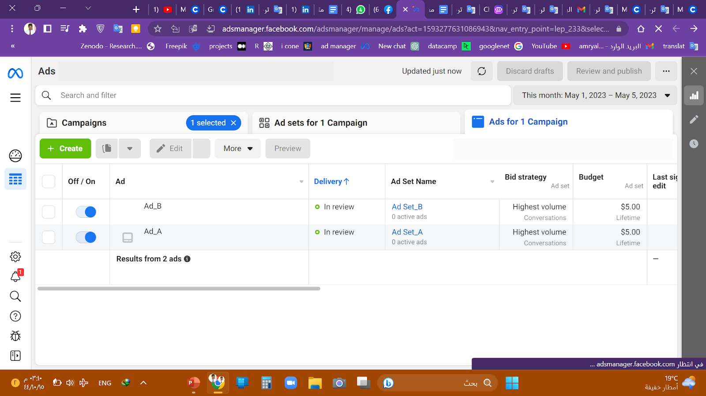
Verify the test
After publishing the ad campaign, the Experiments icon appeared to us, indicating that the test was published successfully
The details are as follows:
We created an ad campaign called "the First Fampaign of the "Sumar"season"
It contains two ad set, Ad Set_A and Ad Set_B, both The two ad sets contain the same variables as
budget and time period
Inside each set of one advertisement Ad_A and
Ad_B. The two ads differ in the image only, as the advertisement contains the image that contains illustrations, and the advertisement B contains the image that does not contain illustrations.
Let's see any of the best pictures.

Slide 15
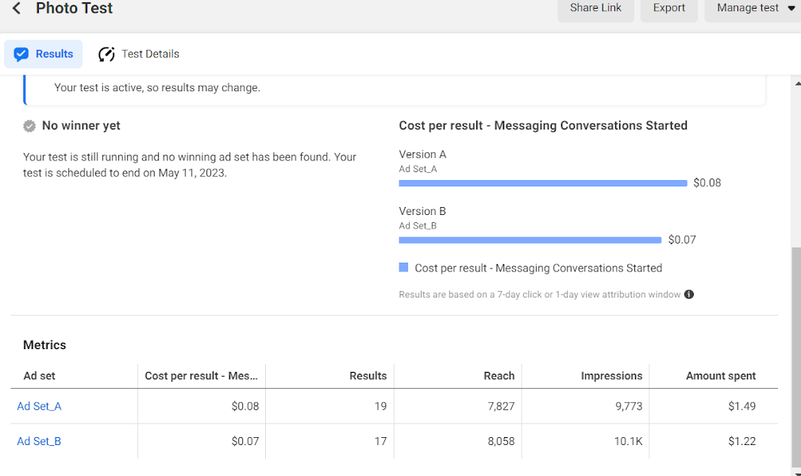
Test tracking
More than a day has passed since the test started and based on the results of the updated A / B test for the two ad sets so far, it seems that Ad Set_B with the image without illustrative texts has produced a little better than Ad Set_A. Ad Set_B has a lower cost per result, the number of appearances, the extent of access and the amount that has been spent slightly higher, with one transfer generation less than
Ad Set_A.
However, it is important to note that the test is still continuing, and it is too early to extract any final conclusions.

Slide 16
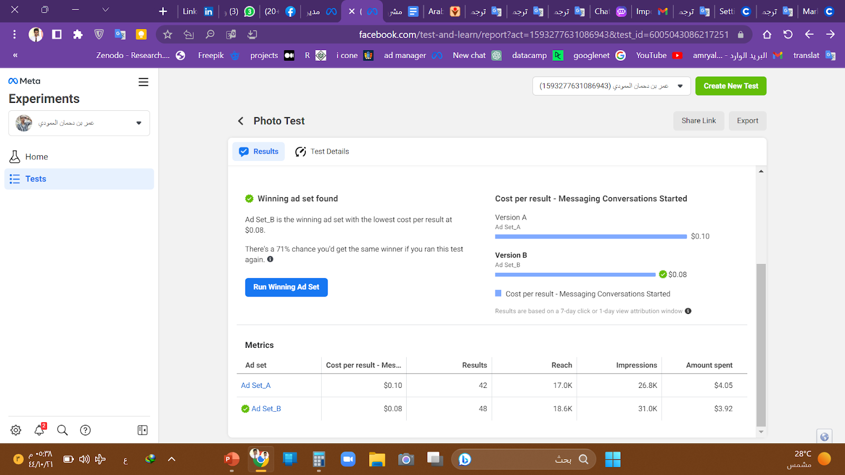
Interpretation the results of the first A/B test
Test results showed that Ad Set_B performed better than Ad Set_A, and Ad Set_B had a lower cost per result ($0.08) than Ad Set_A ($0.10), which means it was more cost effective. Ad Set_B also generated more messaging conversations (48) than Ad Set_A (42), indicating that they were more successful at driving engagement.
In terms of reach and impressions, Ad Set_B performed slightly better than Ad Set_A. Ad Set_A, with more impressions and higher reach. Ad Set_B spent slightly less than Ad Set_A($3.9 vs $4.05) while generating more messaging conversations.

Slide 17

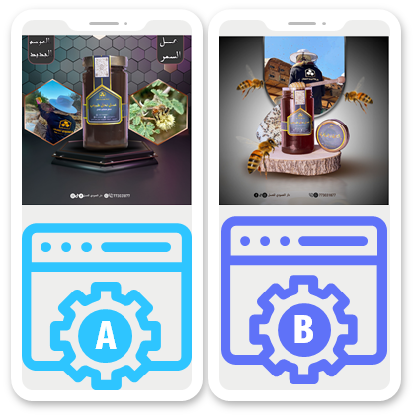
Interpretation the results of the first A/B test
Overall, the A/B test results indicate that Ad Set B, which contained an ad with an image, did not It contained explanatory texts, was more effective in creating message conversations and had a lower cost per result compared to Ad Set A. In the store we can use this information to improve the advertising strategy and increase sales during the new 'Sumar' season.

Slide 18
Ad text testing
B
We then move on to the second ad text test to continue improving the marketing strategy to increase sales by conducting A/B tests between the first and second ad text.
C

Slide 19
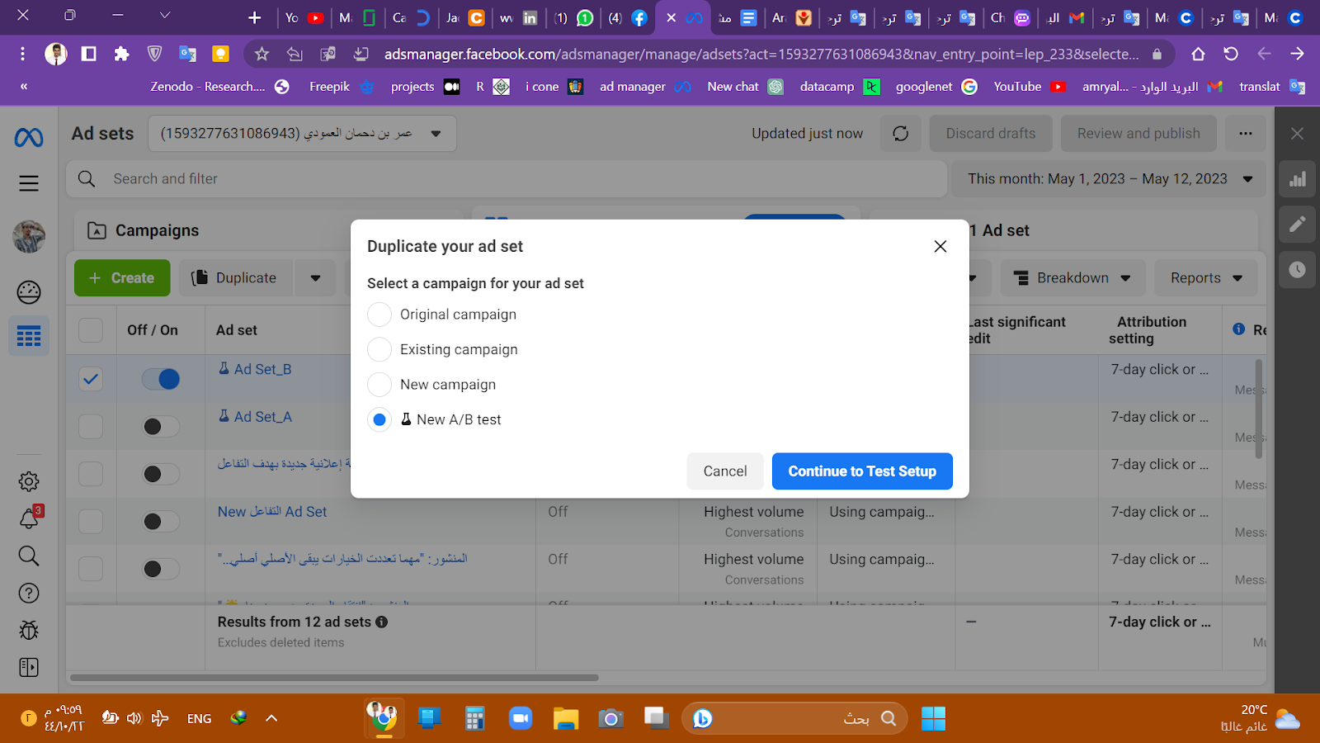
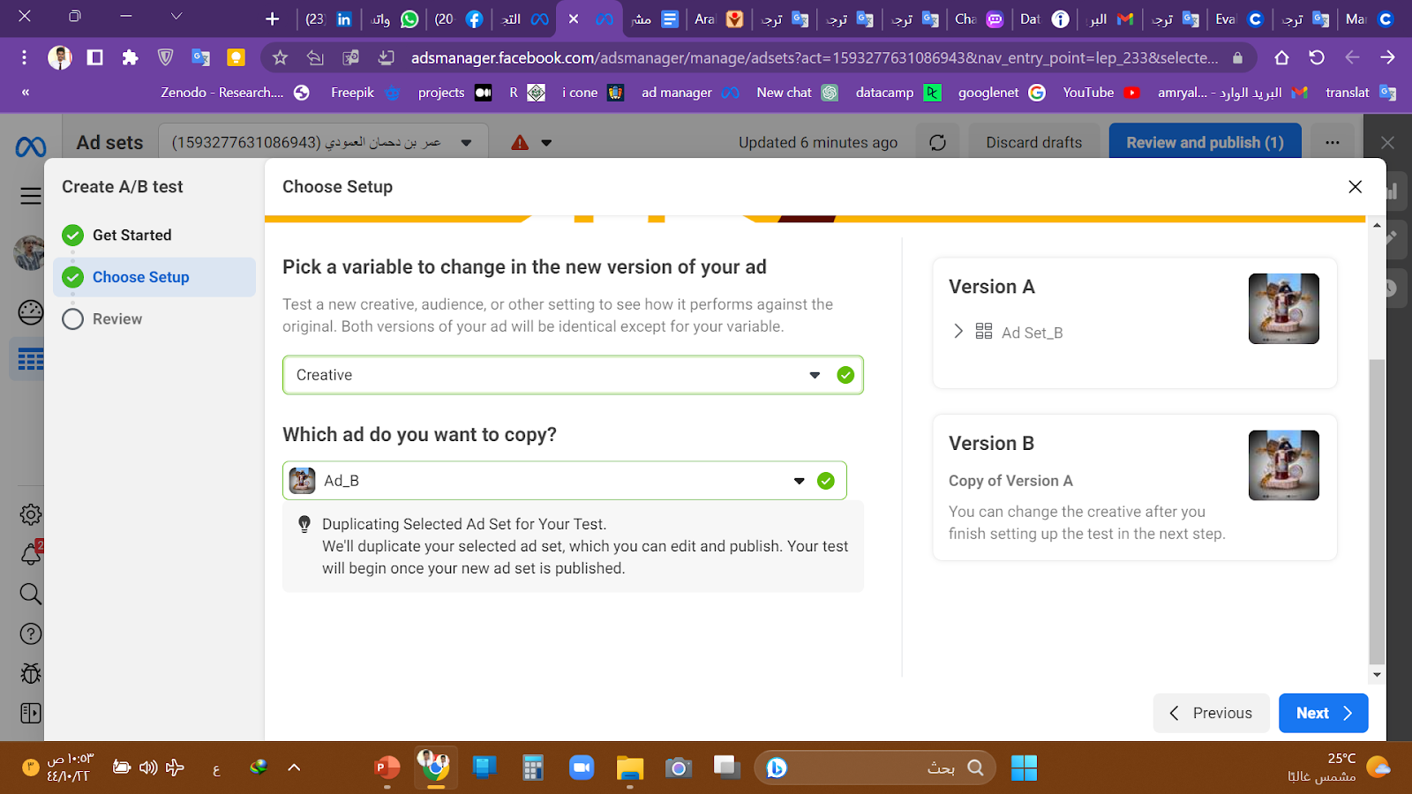
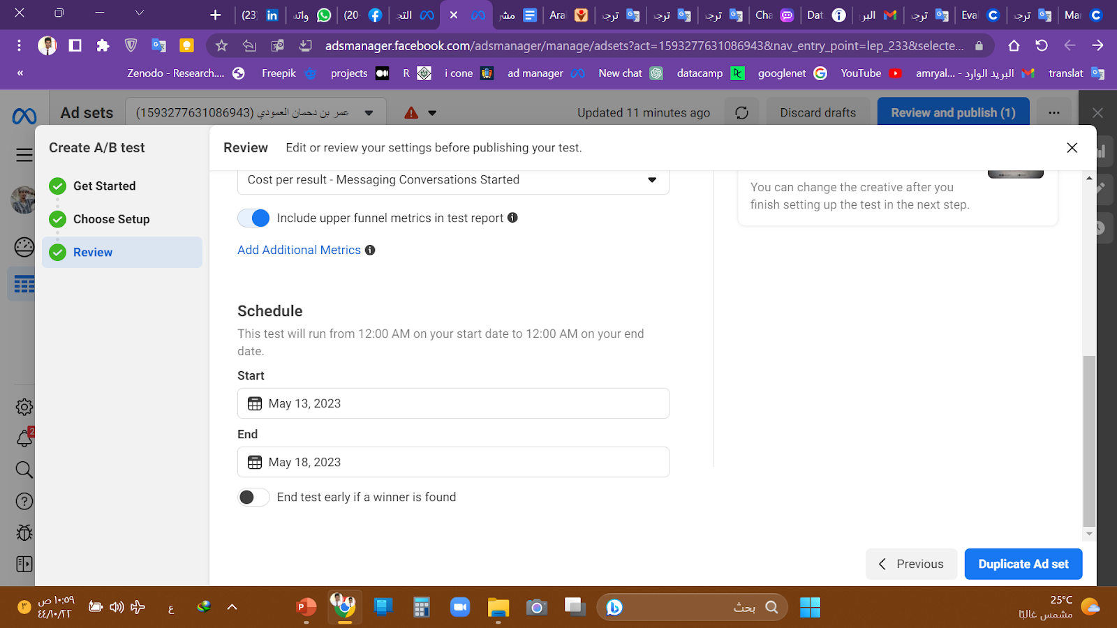
Second test setup
We first duplicate the winning ad group to make it a new A/B test.
Since we only want to change the text, we choose the Creative variable.
We named the ad text test and set the metric cost per result - message conversations began.
We set the test duration and the end test button turns off when a winner is found.

Slide 20
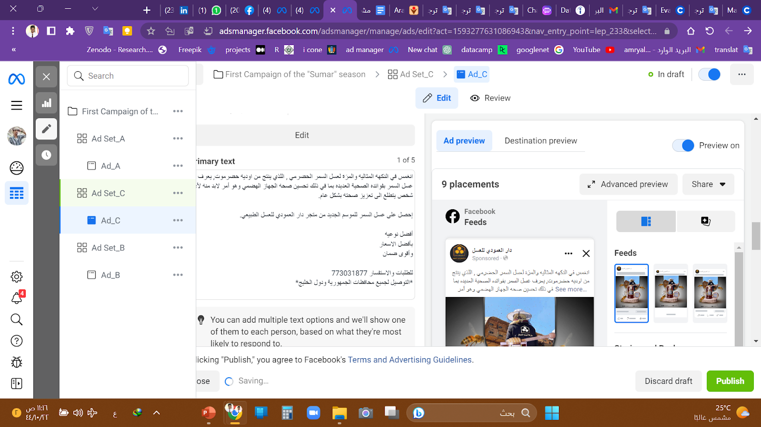
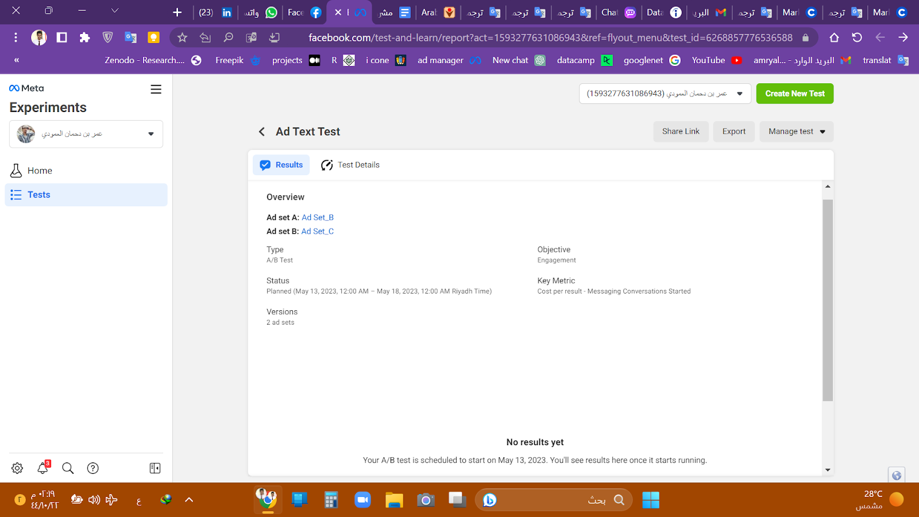
Second test setup
Hence, we named Ad_Set_C and Ad_C
to distinguish between ad Sets.
We only changed the ad text and left all the variables as they appear.
And now the test is ready, we await the results after the end of the specified period for the test.

Slide 21
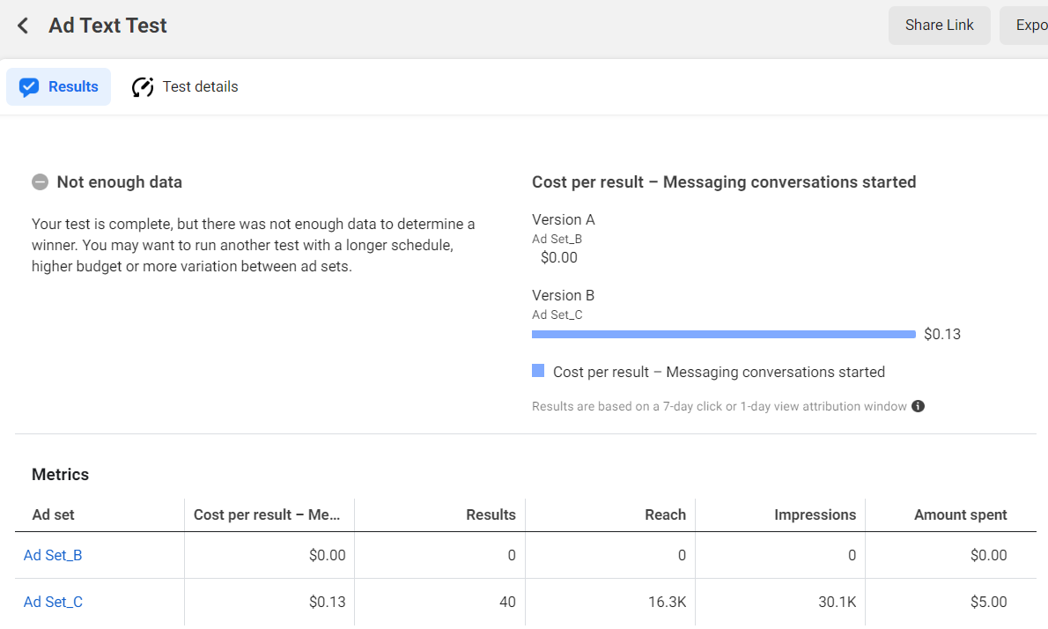
Interpretation of the results of the second test
After the end of the test unfortunately, there is not enough data to determine a winner for the second A/B test between ad_B and ad_C. However, the data for ad_C shows that it had a higher cost per result ($0.13) compared to ad_B ($0.08), and generated fewer messaging conversations (40 vs 48) and reach (16.3K vs 18.6K). Ad_C also spent more than ad_B ($5.00 vs $3.92).
While this data is not enough to determine a winner, it suggests that ad_B may be the better performing ad set.

Slide 22
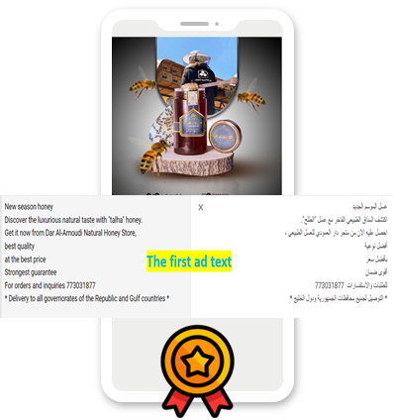
Summarize insights
The results of the A/B testing project that we conducted at Dar Al-Amoudi store indicate that the ad set with the image without explanatory text
(Ad_Set B) was more effective in generating messaging conversations and had a lower cost per result compared to the ad set with the image with explanatory text (Ad_Set A). This suggests that customers were more drawn to the image without text, and that this type of image may be more effective in increasing sales of natural honey products during the new "Sumar" season.
In the second test between Ad_Set B and Ad_Set C, the data is not enough to determine a winner, but it does suggest that Ad_Set B may be the best performing ad set. However, it is important to note that more data may be needed to make a conclusive decision on which ad text is more effective in increasing sales.
Overall, the A/B testing project that we conducted at Dar Al-Amoudi store provides valuable insights into the most effective marketing strategies for increasing sales of natural honey products.
By using these insights to optimize their advertising strategy, the store can improve sales and better reach their target audience.

Slide 23




End
By: Omar Al-Amoudi
Omar Alamoudi
amryalamoudui99@gmail.com
+967701590735

